Slide 1
Mathematical Foundations for Data Science
MFDS Team

Slide 2
DSECL ZC416, MFDS
Lecture No. 15

Slide 3
Agenda
Solving linear recurrence relations
Linear homogeneous recurrence relations with constant coefficients
Characteristic equation and multiplicity
Linear nonhomogeneous recurrence relations with constant coefficients

Slide 4
Linear Homogeneous Recurrence Relations
Definition: A linear homogeneous recurrence relation of degree k with constant coefficients is a recurrence relation of the form
a_{n} = c₁a_{n−1} + c₂a_{n−2} + ….. + c_{k} a_{n−k ,}
where c₁, c₂, ….,c_{k} are real numbers, and c_{k} ≠ 0
it is linear because the right-hand side is a sum of the previous terms of the sequence each multiplied by a function of n.
it is homogeneous because no terms occur that are not multiples of the a_{j}s. Each coefficient is a constant.
the degree is k because a_{n} is expressed in terms of the previous k terms of the sequence.

Slide 5
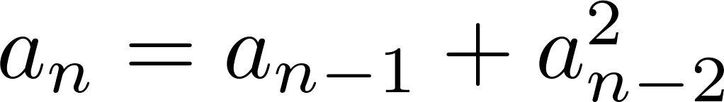
Examples of Linear Homogeneous Recurrence Relations
P_{n} = (1.11)P_{n-1} linear homogeneous recurrence relation of degree one
f_{n} = f_{n-1} + f_{n-2} linear homogeneous recurrence relation of degree two
not linear
H_{n} = 2H_{n−1} + 1 not homogeneous
B_{n} = nB_{n−1} coefficients are not constants

Slide 6
Linear Homogeneous Recurrence Relations
Consider a linear homogeneous recurrence relation of degree k with constant coefficients
a_{n} = c₁a_{n−1} + c₂a_{n−2} + ….. + c_{k} a_{n−k ,}
where c₁, c₂, ….,c_{k} are real numbers, and c_{k} ≠ 0
By strong induction, a sequence satisfying such a recurrence relation is uniquely determined by
the recurrence relation and
the k initial conditions a₀ = C₁, a₀ = C₁ ,… , a_{k−1} = C_{k−1}.

Slide 7
Solving Linear Homogeneous Recurrence Relations
The basic approach is to look for solutions of the form a_{n} = r^{n}, where r is a constant.
Note that a_{n} = r^{n} is a solution to the recurrence relation a_{n} = c₁a_{n−1} + c₂a_{n−2} + ⋯ + c_{k} a_{n−k} if and only if r^{n} = c₁r^{n−1} + c₂r^{n−2} + ⋯ + c_{k} r^{n−k} .
Algebraic manipulation yields the characteristic equation:
r^{k} − c₁r^{k−1} − c₂r^{k−2} − ⋯ − c_{k−1}r − c_{k} = 0

Slide 8
Solving Linear Homogeneous Recurrence Relations
The sequence {a_{n}} with a_{n} = r^{n} is a solution if and only if r is a solution to the characteristic equation.
The solutions to the characteristic equation are called the characteristic roots of the recurrence relation. The roots are used to give an explicit formula for all the solutions of the recurrence relation.

Slide 9
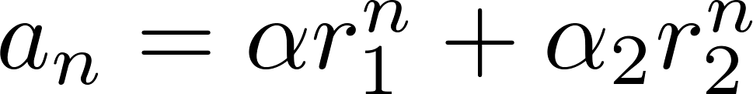
Theorem 1 Solving Linear Homogeneous Recurrence Relations of Degree Two
Let c₁ and c₂ be real numbers. Suppose that r² – c₁r – c₂ = 0 has two distinct roots r₁ and r₂.
Then the sequence {a_{n}} is a solution to the recurrence relation a_{n} = c₁a_{n−1} + c₂a_{n−2} if and only if
for n = 0,1,2,… , where α₁ and α₂ are constants.

Slide 10
Using Theorem 1
Example: What is the solution to the recurrence relation a_{n} = a_{n−1} + 2a_{n−2} with a₀ = 2 and a₁ = 7?
Solution:
The characteristic equation is r² − r − 2 = 0. Its roots are r = 2 and r = −1 . Therefore, {a_{n}} is a solution to the recurrence relation if and only if a_{n} = α₁2^{n} + α₂(−1)^{n}, for some constants α₁ and α₂.
To find the constants α₁ and α₂, note that a₀ = 2 = α₁ + α₂ and a₁ = 7 = α₁2 + α₂(−1).
Solving these equations, we find that α₁ = 3 and α₂ = −1.
Hence, the solution is the sequence {a_{n}} with a_{n} = 3∙2^{n} − (−1)^{n}.

Slide 11
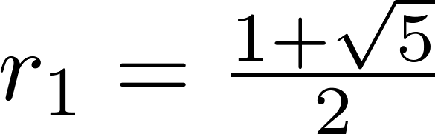
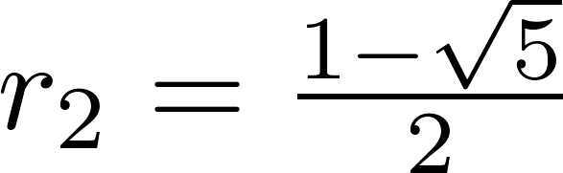
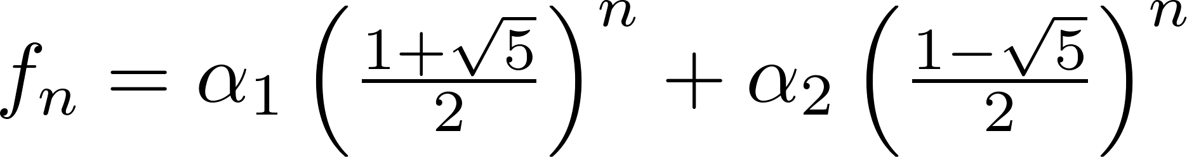
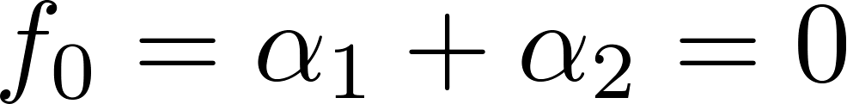
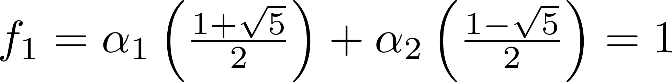
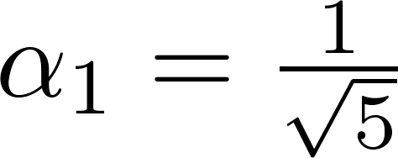
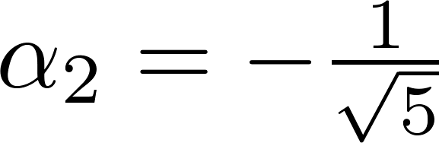
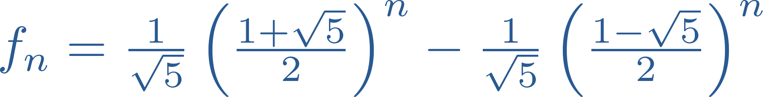
An Explicit Formula for the Fibonacci Numbers
We can use Theorem 1 to find an explicit formula for the Fibonacci numbers. The sequence of Fibonacci numbers satisfies the recurrence relation f_{n} = f_{n−1} + f_{n−2} with the initial conditions: f₀ = 0 and f₁ = 1.
Solution: The roots of the characteristic equation r² – r – 1 = 0 are
for some constants α₁ and α₂.
By Theorem 1
Using the initial conditions f₀ = 0 and f₁ = 1 , we have

Slide 12
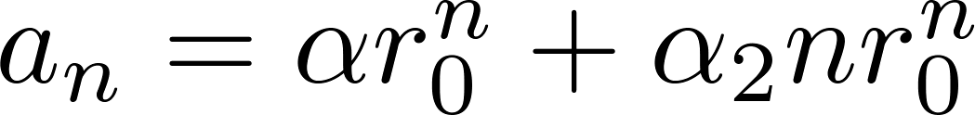
Theorem 2 The Solution when there is a Repeated Root
Theorem 2: Let c₁ and c₂ be real numbers with c₂ ≠ 0. Suppose that r² – c₁r – c₂ = 0 has one repeated root r₀. Then the sequence {a_{n}} is a solution to the recurrence relation a_{n} = c₁a_{n−1} + c₂a_{n−2} if and only if
for n = 0,1,2,… , where α₁ and α₂ are constants.
Example: What is the solution to the recurrence relation a_{n} = 6a_{n−1} − 9a_{n−2} with a₀ = 1 and a₁ = 6?
Solution:
The characteristic equation is r² − 6r + 9 = 0. The only root is r = 3. Therefore, {a_{n}} is a solution to the recurrence relation if and only if a_{n} = α₁3^{n} + α₂n(3)^{n} where α₁ and α₂ are constants.
To find the constants α₁ and α₂, note that a₀ = 1 = α₁ and a₁ = 6 = α₁ ∙ 3 + α₂ ∙3.
Solving, we find that α₁ = 1 and α₂ = 1 . Hence, a_{n} = 3^{n} + n3^{n} .

Slide 13
Theorem 3 Solving Linear Homogeneous Recurrence Relations of Arbitrary Degree
Theorem 3: Let c₁, c₂ ,…, c_{k} be real numbers. Suppose that the characteristic equation r^{k} – c₁r^{k−1} –⋯ – c_{k} = 0 has k distinct roots r₁, r₂, …, r_{k}. Then a sequence {a_{n}} is a solution of the recurrence relation a_{n} = c₁a_{n−1} + c₂a_{n−2} + ….. + c_{k} a_{n−k} if and only if for n = 0, 1, 2, …, where α₁, α₂,…, α_{k} are constants.
This theorem can be used to solve linear homogeneous recurrence relations with constant coefficients of any degree when the characteristic equation has distinct roots.

Slide 14
Theorem 4 The General Case with Repeated Roots Allowed
Theorem 4: Let c₁, c₂ ,…, c_{k} be real numbers. Suppose that the characteristic equation r^{k} – c₁r^{k−1} –⋯ – c_{k} = 0 has t distinct roots r₁, r₂, …, r_{t} with multiplicities m₁, m₂, …, m_{t}, respectively so that m_{i} ≥ 1 for i = 0, 1, 2, …,t and m₁ + m₂ + … + m_{t} = k. Then a sequence {a_{n}} is a solution of the recurrence relation a_{n} = c₁a_{n−1} + c₂a_{n−2} + ….. + c_{k} a_{n−k}
if and only if
for n = 0, 1, 2, …, where α_{i,j} are constants for 1≤ i ≤ t and 0≤ j ≤ m_{i−1}.

Slide 15
Linear Non-homogeneous Recurrence Relations with Constant Coefficients
Definition: A linear nonhomogeneous recurrence relation with constant coefficients is a recurrence relation of the form:
a_{n} = c₁a_{n−1} + c₂a_{n−2} + ….. + c_{k} a_{n−k} + F(n) ,
where c₁, c₂, ….,c_{k} are real numbers, and F(n) is a function not identically zero depending only on n.
The recurrence relation a_{n} = c₁a_{n−1} + c₂a_{n−2} + ….. + c_{k} a_{n−k ,} is called the associated homogeneous recurrence relation.

Slide 16
Linear Non-homogeneous Recurrence Relations with Constant Coefficients (cont.)
The following are linear nonhomogeneous recurrence relations with constant coefficients:
a_{n} = a_{n−1} + 2^{n} ,
a_{n} = a_{n−1} + a_{n−2} + n² + n + 1,
a_{n} = 3a_{n−1} + n3^{n} ,
a_{n} = a_{n−1} + a_{n−2} + a_{n−3} + n!
where the following are the associated linear homogeneous recurrence relations, respectively:
a_{n} = a_{n−1 ,}
a_{n} = a_{n−1} + a_{n−2},
a_{n} = 3a_{n−1} ,
a_{n} = a_{n−1} + a_{n−2} + a_{n−3}

Slide 17
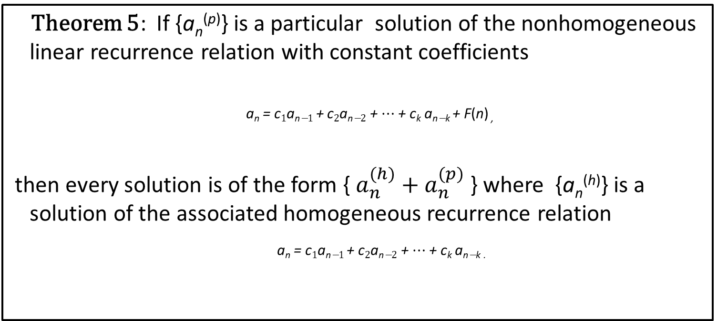
Solving Linear Non-homogeneous Recurrence Relations with Constant Coefficients
Theorem 5: If {a_{n}^{(p)}} is a particular solution of the nonhomogeneous linear recurrence relation with constant coefficients
a_{n} = c₁a_{n−1} + c₂a_{n−2} + ⋯ + c_{k} a_{n−k} + F(n) ,
then every solution is of the form { } where {a_{n}^{(h)}} is a solution of the associated homogeneous recurrence relation
a_{n} = c₁a_{n−1} + c₂a_{n−2} + ⋯ + c_{k} a_{n−k .}

Slide 18
Solving Linear Non-homogeneous Recurrence Relations with Constant Coefficients (continued)
Example: Find all solutions of the recurrence relation a_{n} = 3a_{n−1} + 2n. What is the solution with a₁ = 3?
Solution: The associated linear homogeneous equation is a_{n} = 3a_{n−1}.
Its solutions are a_{n}^{(h)} = α3^{n}, where α is a constant.
Because F(n)= 2n is a polynomial in n of degree one, to find a particular solution we might try a linear function in n, say p_{n} = cn + d, where c and d are constants.
Suppose that p_{n} = cn + d is such a solution.
Then a_{n} = 3a_{n−1} + 2n becomes cn + d = 3(c(n− 1) + d)+ 2n.

Slide 19
Solving Linear Non homogeneous Recurrence Relations with Constant Coefficients (continued)
Simplifying yields (2 + 2c)n + (2d − 3c) = 0. It follows that cn + d is a solution if and only if 2 + 2c = 0 and 2d − 3c = 0.
Therefore, cn + d is a solution if and only if c = − 1 and d = − 3/2. Consequently, a_{n}^{(p)} = −n − 3/2 is a particular solution.
By Theorem 5, all solutions are of the form
a_{n} = a_{n}^{(p)} + a_{n}^{(h)} = −n − 3/2 + α3^{n}, where α is a constant.
To find the solution with a₁ = 3, let n = 1 in the above formula for the general solution. Then 3 = −1 − 3/2 + 3 α, and α = 11/6.
Hence, the solution is
a_{n} = −n − 3/2 + (11/6)3^{n}.

Slide 20
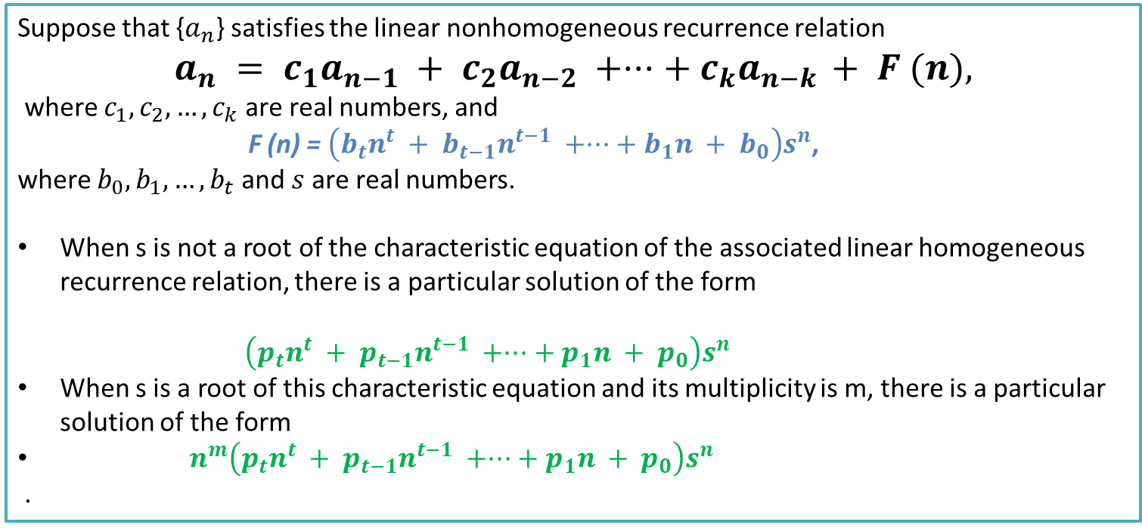
Theorem 6
Suppose that {} satisfies the linear nonhomogeneous recurrence relation
where are real numbers, and
F (n) = ,
where and are real numbers.
When s is not a root of the characteristic equation of the associated linear homogeneous recurrence relation, there is a particular solution of the form
When s is a root of this characteristic equation and its multiplicity is m, there is a particular solution of the form
.

Slide 21
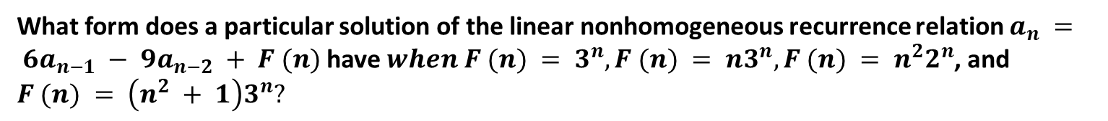
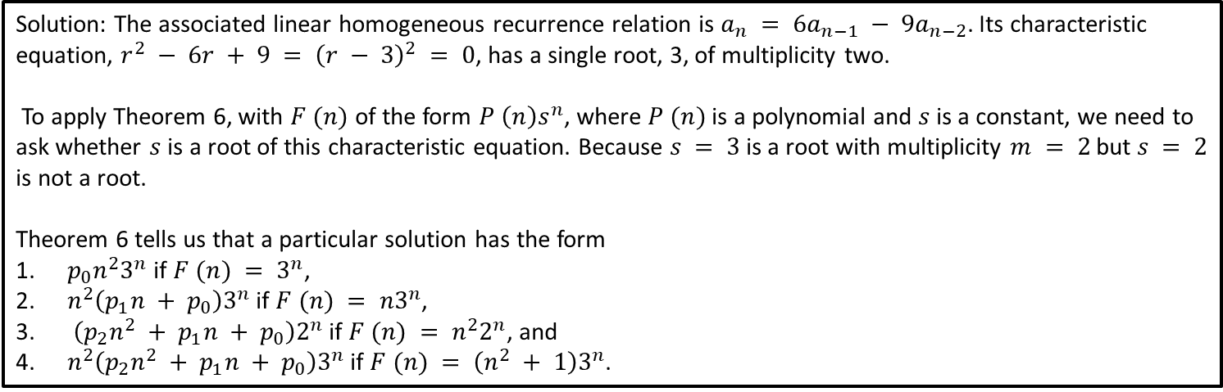
Example
What form does a particular solution of the linear nonhomogeneous recurrence relation have , and
Solution: The associated linear homogeneous recurrence relation is . Its characteristic equation, , has a single root, 3, of multiplicity two.
To apply Theorem 6, with of the form , where is a polynomial and is a constant, we need to ask whether is a root of this characteristic equation. Because is a root with multiplicity but is not a root.
Theorem 6 tells us that a particular solution has the form
if ,
if ,
if , and
if .

